Slide 1

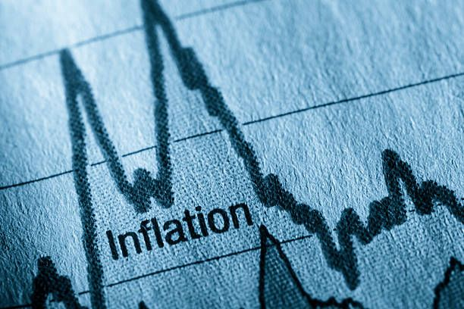
U.S. Inflation Data
-NIDHIN RAJ
Notes:
This project analyzes U.S. CPI data from 2011 to 2021 to find patterns and predict future inflation trends. It helps us understand price changes and their impact on the economy."

Slide 2
Problem Statement
The objective of this project is to study past Consumer Price Index (CPI) data to identify trends and seasonal patterns. Using this, we aim to create a reliable forecasting model. The predicted CPI will help in estimating inflation, making better economic decisions, and assisting businesses, policymakers, and financial institutions in planning for the future.
Notes:
"U.S. CPI changes over time mainly due to three reasons:
Prices of goods and services increasing (inflation).
Changes in government policies or regulations.
Major events like economic crises or global pandemics.
Understanding these changes helps predict future inflation and guides better financial planning for businesses and individuals."

Slide 3
About Data
Source: Kaggle
Time Period: JAN 2011 to JULY 2021.
Variables:
Yearmon: A time variable representing monthly frequency.
CPI: Continuous variable representing the Consumer Price Index, a measure of the average price level for a basket of goods and services.
Number of Observations: 127.
Notes:
"This data is sourced from Kaggle and covers the period from January 2011 to July 2021, consisting of 127 monthly records. It includes two variables: Yearmon, which represents the monthly time variable, and CPI, which measures the average prices for goods and services. Seasonal adjustment is applied to remove recurring patterns in the data, allowing us to focus on long-term trends and changes."

Slide 4
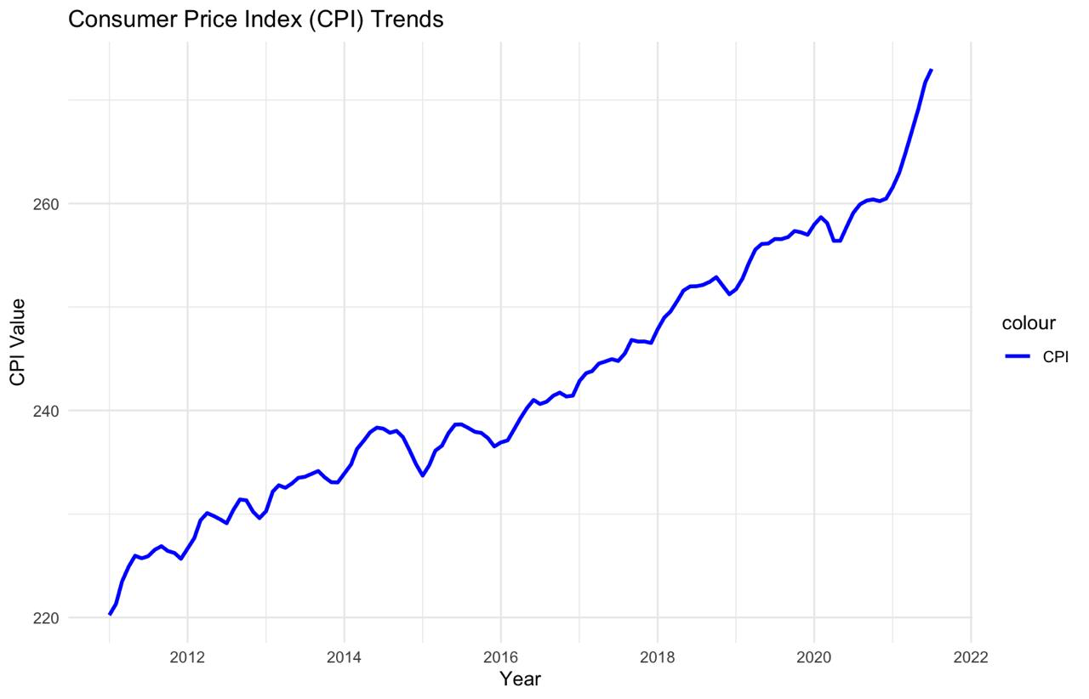
Trend
Notes:
This graph shows monthly changes in U.S. CPI from 2011 to 2021. Over time, prices steadily increased due to inflation, rising demand, and economic factors like supply chain disruptions. Sharp changes occurred during significant events. These patterns help us understand past trends. They also guide predictions for future price changes."

Slide 5
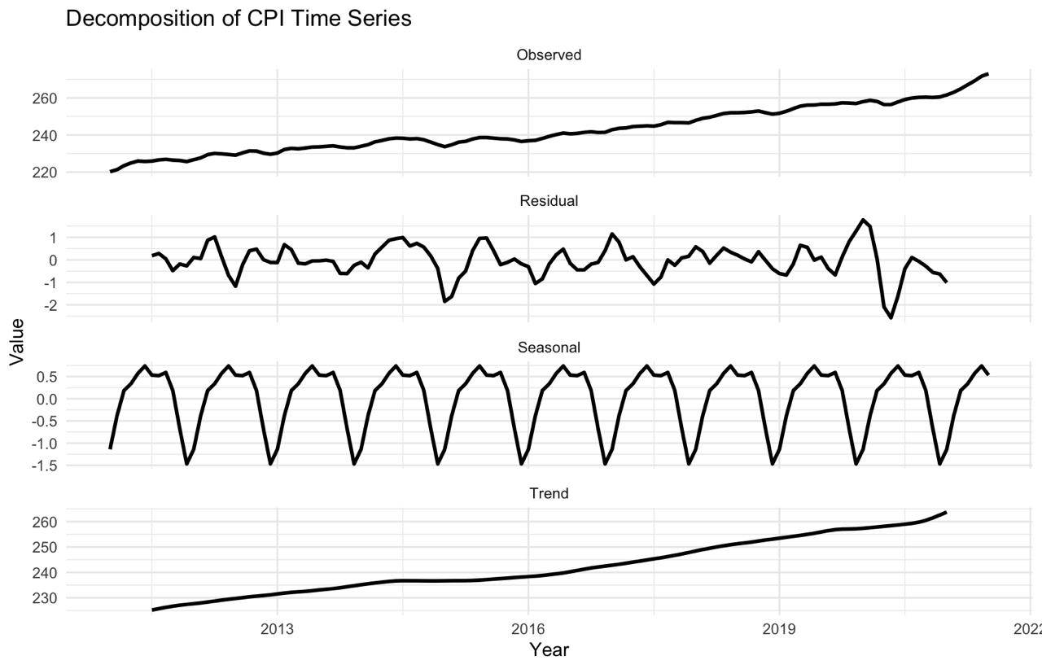
Decomposition Graph
Notes:
Observed (CPI): The original data showing overall price changes over time, including trends and variations.
Trend: Displays the long-term movement in prices, showing a steady rise due to inflation and economic factors.
Seasonality: Highlights recurring patterns, such as annual price changes linked to seasonal demand.
Residuals: Represents random fluctuations or unexpected changes, such as sudden shifts caused by major events.

Slide 6
Deciding The Forecasting Model
Seasonal ARIMA (SARIMA): Perfect for capturing both trend and recurring seasonal patterns in the data.
Holt-Winters Smoothing: A reliable approach for handling time series with trend and seasonality effectively.
Notes:
In this stage, we choose the best forecasting models based on the insights from the decomposition graphs:
Seasonal ARIMA (SARIMA):
This model is perfect for data that shows both trends and seasonal patterns.
It uses a combination of autoregressive, differencing, and moving average components along with seasonal adjustments to make accurate predictions.
Holt-Winters Smoothing:
This method is highly effective for handling time series with trends and seasonality.
It prioritizes recent data, ensuring more accurate and responsive forecasts.

Slide 7
Conclusion
The analysis of the Consumer Price Index (CPI) revealed strong trend and seasonal patterns, which are critical for accurate forecasting.
Seasonal ARIMA (SARIMA) and Holt-Winters Exponential Smoothing were identified as suitable forecasting models based on the data decomposition results.
Notes:
To summarize, using Seasonal ARIMA (SARIMA) and Holt-Winters models enables accurate CPI forecasting by effectively capturing trends and seasonal patterns. These forecasts offer crucial insights for better economic planning and decision-making. Understanding these patterns helps policymakers and businesses take proactive steps for smarter and more informed strategies in the future.

Slide 8

Thank You
Notes:
No Trend or Seasonality: Simple Exponential Smoothing.
Trend but No Seasonality: Holt’s Exponential Smoothing
Trend and Seasonality: Holt-Winters Exponential Smoothing.
Cyclical Patterns: ARIMA (AutoRegressive Integrated Moving Average)
• Trend: The long-term direction of the data (increasing, decreasing, or stable).
• Seasonality: Regular patterns that repeat at specific intervals (like higher ice cream sales in summer).
• Cyclic Patterns: Fluctuations that occur over longer periods, often influenced by economic or business cycles.

